Slide 1
Model Based Design of Cockpit Display Logic
Hualong Yu
Pilot Team, The MathWorks

Slide 2
Key Points
Model-Based Design provides a complete solution to design, test and implement cockpit display logic
State machines and flow charts clearly represent logic for display systems
With Model-Based Design, you continuously test to check that the design meets requirements

Slide 4


Slide 5
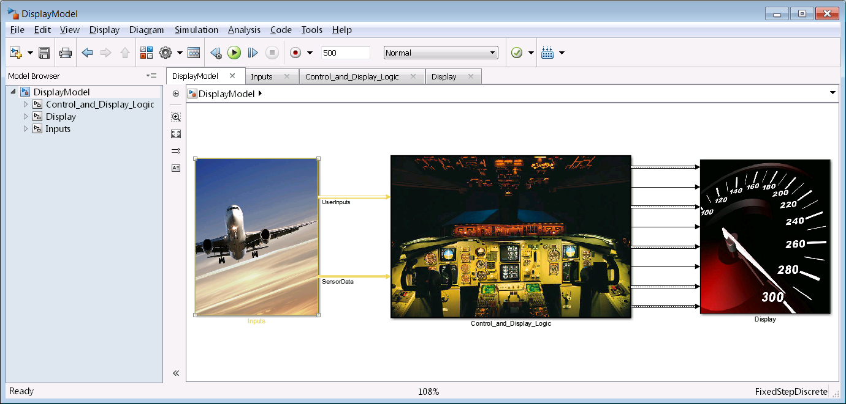
Demo

Slide 6

Cockpit Display Systems
Specifications
(.TXT, DOORS)
Inputs
<User Input>
Display Code
Glue Code
Control Logic
Display Code
<User Input>
<Sensor Data>
<Warning Msg ID>
<Page IDs>
<Sensor Data>
Signal Conditioning
Warning Management
Page
Control
Notes:
Here is a simplified version of the architecture of a display system. The system can be broken does into 3 parts. First is the plant. This part represents the various physical components aboard the aircraft for example the hydraulic systems, electrical systems etc. Sensors read data from these systems and send them to the control logic portion. This control logic part represents the controller for the display system. From this part, we send commands to the display part. The display part contains GLUE code and graphics code for actually generating graphics on the DU.
[Advance]
User input is sent from the display part to affect the plant model and affects the control of the system.
My focus for this presentation is on the logic intensive portions of control logic. [Advance]
As you are familiar, this part performs 3 primary functions. First raw sensor data is processed and normalized. The data is then sent to the warning management logic for generating warning IDs. From here, inputs are then used to select pages that should be displayed on the DUs.

Slide 7
Cockpit Display Systems
Specifications
(.TXT, DOORS)
Inputs
Glue Code
Control Logic
Display Code
Simulink
MATLAB
Signal Conditioning
Warning Management
Page
Control
Simulink
Stateflow
Stateflow
Notes:
Note to Presenter: If presenting to an account that is already familiar with our tools, use this slide to explain the strength of each tool and why they were used for each component.
…..
Let us take a few moments to look at the tools used for each of these portions and why.
Simulink: block-design environment for designing controls and signal processing algorithms. So used for signal conditioning. Also used to represent the plant models mathematically.
Stateflow: environment for designing complex logic using graphical and tabular representations of state machines and flow charts.
MATLAB: language for technical computing and desktop visualization.
The focus of our presentation today is on the Control Logic section. Let us look at the challenges faced in these components.

Slide 8
Signal Conditioning
Signal Filter
Sensor 1
Signal Selection
Signal Filter
Sensor 2
Final Signal
Signal Filter
Sensor 3
Signal Filtering algorithms are computationally intensive
Notes:
As I briefly mentioned earlier, this component reads in data from the sensors and passes them through various signal processing algorithms.
[Advance]
In case of redundant sensors, voting mechanisms and data range checks are used to select the final value of the signal. Fault management logic is executed if the faults persistent.
[Advance]
The key challenge here is the complexity of the signal processing routines. Simulink contains a lot of capabilities for signal processing but that is not the focus of today’s presentation.

Slide 9
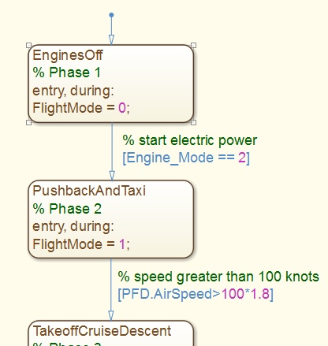
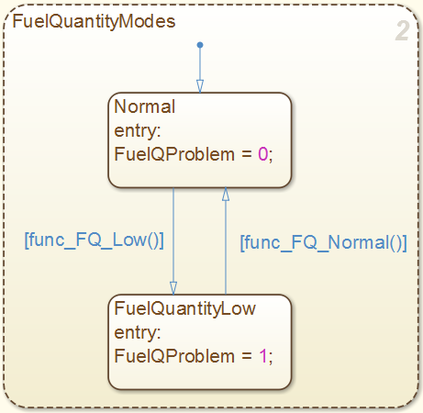
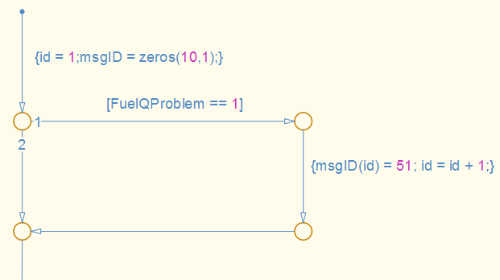
Warning Message Generation
Phases of Flight
Component Modes
Message ID
Generation
Notes:
The warnings generated depend on the phase of flight and the modes of systems like fuel quantity measure aboard the aircraft. The phase of flight is important because only specific signals are monitored in each phase of flight and components can have different conditions for switching between modes based on the phase of flight. Here in the example, the phases of flight are EnginesOff and Pushback and Taxi while Fuel Quantity can either be Normal or Low.
But then you do not have one component or signal to model, there are thousands.

Slide 10

Complex Mode Logic
Phases of Flight
Component Modes
Message ID
Generation
Notes:
And with thousands of signals and each having different modes, it is very important to have a clear representation for this mode mo

Slide 11
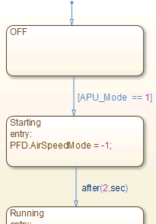

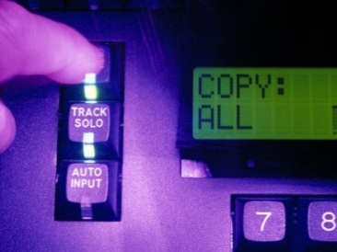
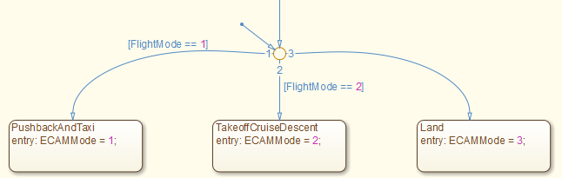
Page Control
Multiple Competing Criteria for page display
H/W Modes
Phases of Flight
Component Modes
User Input
Page Selection
Notes:
Page generation depends on the modes of the display hardware, that is, is it booting up, running etc. Then the other factors are the phases of flight, modes of components (faults) and pilot selection. There is deterministic priority for showing pages on the DUs which is quite complex. Only certain transitions between pages are allowed and the system needs to reach to external events and condition changes.

Slide 12
Challenges with Modeling Cockpit Display Systems
Warning Management contains very complex mode logic
Page Control contains complex decision logic for modeling multiple competing criteria
Notes:
Read the challenges. Let us look at how Model-Based Design can help address some of these issues..

Slide 14
What is the Most Expensive Project Stage to Find Errors In?
Errors introduced early but found late in the process are expensive to fix!
Relative cost to fix an error
Errors introduced in:
coding phase
design phase
requirements phase
Requirements phase
Design phase
Coding phase
Testing phase
Project phase where error is fixed
Source: Return on Investment for Independent Verification & Validation, NASA, 2004.
Notes:
Before I talk about that, lets talk about why we should care about Model Based Design. I looked through some white papers and came across this study by NASA that shows the relative expense of fixing errors based relative to when they are introduced.
Bar color corresponds to the project phase where the error was introduced.
[Advance]
For example the most expensive type of error to fix is an error in the requirements that is only found during testing.
It is very expensive because you will need to go through the whole development process to fix it – not only expensive, but also time-consuming.
So, finding errors early means we can develop our products cheaper and quicker, and that is why it is so important.
[Note to presenter: NASA study can be downloaded directly from http://sarpresults.ivv.nasa.gov/DownloadFile/24/10/Direct%20ROI%20of%20IV&V%20ATS2003%20presentation.ppt
The saved version of the report (powerpoint file) is also available on the ECL).]

Slide 15
Traditional Development Process
RESEARCH
REQUIREMENTS
SPECIFICATIONS
Requirement Documents
Difficult to analyze
Difficult to manage as they change
Paper Specifications
Easy to misinterpret
Difficult to integrate with design
DESIGN
EDA
Algorithm
Design
MCAD/
MCAE
Physical Prototypes
Incomplete and expensive
Prevents rapid iteration
No system-level testing
Electrical Components
Embeddable Algorithms
Mechanical Components
Manual Coding
Time consuming
Introduces defects and variance
Difficult to reuse
IMPLEMENTATION
C/C++
Traditional Testing
Design and integration issues found late
Difficult to feed insights back into design process
Traceability
Embedded Software
INTEGRATION AND TEST
Notes:
Let’s look at a simplified representation of a traditional development to understand why it is difficult to find errors early in designing multi-domain systems.
[ Short Version ]
[Advance]
The complexity in systems is dictating more complex requirements. These more complex requirements are difficult to analyze and to manage as they change.
[Advance]
Complexity of specifications makes them easy to misinterpret. It is also difficult to trace specs to the design.
[Advance]
The controller algorithms are manually tuned on a prototype or on the actual system. Prototypes often are not easily available or let you test only part of the overall system.
[Advance]
Coding is done manually, often resulting in errors when design is not interpreted correctly.
[Advance]
And the integration and test phase is where the problems show up, since that is the first time systems are integrated. The result is that errors are found late and are expensive to fix.
[Advance]
The different tools used throughout the development process make it difficult to understand how the whole system will work and how different components will interact with each other.
If different groups are working on different parts of the projects, there is also a communication problem between them.
[Advance]
So let me introduce Model-Based Design and explain how it will help you detect errors early and therefore allow you to design innovative products with high performance faster and cheaper.
Model-Based Design is a Computer Aided Engineering (CAE) solution for MATHEMATICALLY describing how the equipment will work.
[Advance]

Slide 16
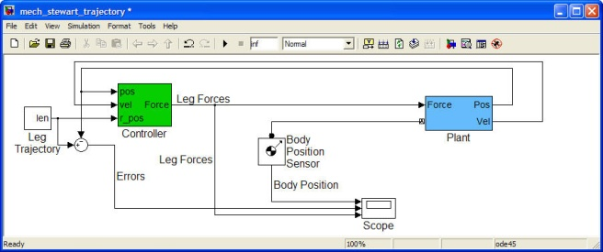
Model-Based Design- Describe the system dynamics
Model-Based Design uses block diagrams to mathematically model the system behavior.
DESIGN
Electrical
Components
Control
Algorithms
You design the way the system should perform.
Embedded
Software
Mechanical
Components
Notes:
With Model-Based Design you combine all these components – mechanical, electrical, control, and software.
[Advance]
in a system-level model of your process or machine.
So the key to Model-Based Design is that you start with a block diagram that mathematically models the system behavior.
By being able to model the system behavior, you can then use dynamic system simulation and try out your ideas. First, you gain an understanding of the overall system that you
are building early in the design. And with this, you can try out different design alternatives, and do initial what-if studies the would be too risky to test directly on the system.

Slide 17
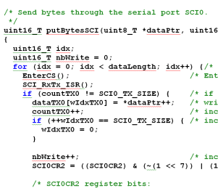
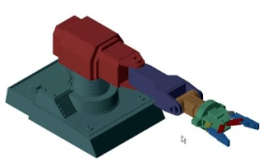
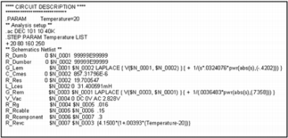
Model-Based Design- Design and test using simulation
RESEARCH
REQUIREMENTS
Requirements are linked to the model.
DESIGN
Environmental Models
Detail is added from specific domains to refine the model.
Mechanical
Electrical
Control Algorithms
Intellectual property and engineering data are reused from existing designs and CAE tools, such as CAD, FEA, and SPICE models.
Supervisory Logic
Testing control algorithms against requirements is done by simulating the model.
Notes:
For engineers, block diagrams are easier to understand than text – because they are visual.
[Advance]
In essence, a block diagram complements the text requirements to communicate design intent.
Actually you can take the text requirements that you have and electronically connect them to your model to show which part of the model implements which requirement.
[ Advance]
This model is elaborated to include all the different elements of the design and operating conditions in one environment.
[ Advance]
You can reuse existing intellectual property and engineering data from existing designs and tools that you use, such as CAD, FEA, and SPICE.
[ Advance]
The model is not only a graphical representation of your design, but it can also simulate.
Therefore we say that the model serves as an executable specification.
So the fact that the model is visual, easy to understand and executable, removes the ambiguity from interpreting the text requirements.
We can start testing the design and requirements through simulation of this system model - very early in the process.
And we can then rapidly iterate on the design, continuously testing and ensuring that we are meeting our requirements and that our requirements are correct.
All the work that you spend in building and developing these models is not wasted because you reuse this model or components of this model for real-time testing.

Slide 18
Model-Based Design- Test and validate in real-time
RESEARCH
REQUIREMENTS
Automatically generate code from the simulation model for real-time testing of the control algorithms.
DESIGN
Environmental Models
Mechanical
Electrical
Automatically generate code from the simulation model for real-time system simulation of hardware for testing the real microcontroller, FPGA, or PLC
Control Algorithms
Supervisory Logic
REAL-TIME TESTING
C, C++
VHDL, Verilog
Structured Text
MCU
DSP
FPGA
ASIC
PLC
Notes:
You can automatically generate code for the control algorithm and test that control out in real-time against some prototype hardware that you have. Additionally, if you do not have all your hardware available at once, you can simulate aspects of your plant system as well, by generating code for those components.
This testing, of course, continues to check that requirements are being met. You reuse the tests that you have already established for the model, and you can continue to rapidly iterate on your design.

Slide 19
Model-Based Design- Implement embedded software
RESEARCH
REQUIREMENTS
Automatically generate code from the simulation model for implementing directly on production targets:
Microcontrollers
FPGAs
PLC IDEs
DESIGN
Environmental Models
Mechanical
Electrical
Control Algorithms
Supervisory Logic
TEST & VERIFICATION
IMPLEMENTATION
C, C++
VHDL, Verilog
Structured Text
MCU
DSP
FPGA
ASIC
PLC
INTEGRATION
Notes:
Automatic code generation is also applicable to then implement your final controller in either software for a microprocessor, hardware for an FPGA, or even PLC environment.
This highlights four aspects of Model-Based Design, that can be summarized as follows.

Slide 20
Model-Based Design Summary
Provides a CAE solution for multidomain system-level development of embedded controllers
Uses a simulation model to mathematically describe the system-level behavior of complex equipment
Automatically generates code from the model to help you with real-time testing and with implementation
Lets you test continuously throughout the development process
Executable
Specifications
Design
with
Simulation
Models
Continuous
Test and
Verification
Automatic
Code Generation
Notes:
It provides CAE solution for multi-domain system-level development of embedded controllers.
[Advance]
It is using mathematical models to describe the system level behavior of your complex equipment to improve your design.
[Advance]
You are automatically generating code for real-time testing and implementation of your design - from these models.
And finally,
[Advance]
Testing is done continuously to let you find errors and conflicting requirements early in the design where they are cheaper and easier to correct.
Next, let’s specifically look at a couple of customer examples who used Model-Based Design.

Slide 21

Airbus Develops Fuel Management System for the A380 Using Model-Based Design
Challenge
Develop a controller for the Airbus A380 fuel management system
Solution
Use MATLAB, Simulink, and Stateflow for Model-Based Design to model and simulate the control logic, communicate the functional specification, and accelerate the development of simulators
Results
Months of development time eliminated
Models reused throughout development
Additional complexity handled without staff increases
Airbus A380, the world’s largest commercial aircraft.
“Model-Based Design gave us advanced visibility into the functional design of the system. We also completed requirements validation earlier than was previously possible and simulated multiple simultaneous component failures, so we know what will happen and have confidence that the control logic will manage it.”
Christopher Slack Airbus
Link to user story
Notes:
Challenge: The Airbus 380 has over 20 fuel pumps and 40 valves to manage fuel system for the aircraft. The system was described with about a thousand requirements. The objective was to understand how the system behaves under multiple faults. It is can be very hard to predict how this system will behave with multiple small failures. Moreover, it can be very challenging to identify which requirement on page 5 conflicts with that on page 20.
Airbus used Simulink and Stateflow as part of model based design to create a model of the system that was reused throughout the project. The system had about 45 charts, and 6000 states.
They saved months of time by using simulation with Model-based design as their solution.

Slide 22
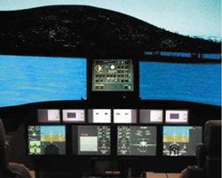
Gulfstream Aerospace Develops Pilot-in-the-Loop Aircraft Simulator with MathWorks Tools
Challenge
Develop a pilot-in-the-loop aircraft simulation facility for real-time evaluation of control law designs and flight displays
Solution
Use Simulink, Aerospace Blockset, and Simulink Coder to model and simulate the digital flight-control system and aircraft dynamics in real time
Results
Successful first flight
Accelerated development
Realistic flight-test preparation environment
Cockpit of Gulfstream’s aircraft simulator.
“On a tight schedule, we developed a pilot-in-the-loop simulation lab in which we can easily evaluate various control systems and rapidly adjust the feedforward path of the control laws if needed. Without MathWorks tools we would not have met our deadline.”
Nomaan Saeed Gulfstream Aerospace
Link to user story
Notes:
Gulfstream engineers needed to build a flexible pilot-in-the-loop aircraft simulation facility, including a six-degrees-of-freedom simulation of the aircraft, in preparation for a scheduled flight test of a modified Gulfstream G550.
Gulfstream engineers used Simulink, Aerospace Blockset, and Simulink Coder™ to develop the simulator and evaluate control law designs in real time during simulated flight.
Without MathWorks tools, we would not have met our deadline," notes Saeed. "By using the same tools to develop the aircraft dynamics model and the pilot-in-the loop simulation, we could rapidly develop and evaluate the control system.“
Gulfstream used the simulation laboratory to prepare test pilots for flight testing. The pilots reported that the simulator closely matched the flight characteristics of the actual aircraft and provided an outstanding environment to prepare for flight tests.
Now let us go back and look at how to apply Model Based Design for solving the challenges that we had listed earlier with designing cockpit display systems.

Slide 23
Challenges with Modeling Cockpit Display Systems
Warning Management contains very complex mode logic
Page Control contains complex decision logic for modeling multiple competing criteria
Notes:
The first challenge was that we needed a good way to represent complex mode logic.

Slide 24
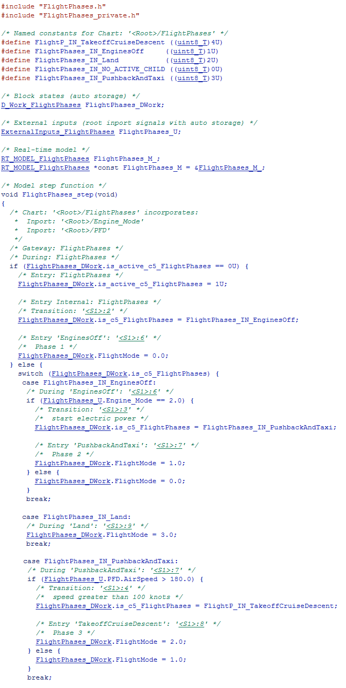
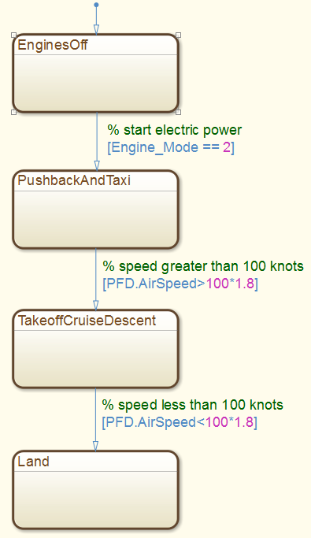
Use state machines for
Mode Logic
Notes:
The representation on the left if one way to represent the modes of the aircraft and then
[Advance]
you can use a graphical representation like this. From the representation on the right, it is clear that this design has 4 components and the conditions for transition are also evident.
[Advance]
So we suggest the use of graphical state machines for representing mode logic.

Slide 25
Challenges with Modeling Cockpit Display Systems
Warning Management contains very complex mode logic
Page Control contains complex decision logic for modeling multiple competing criteria
Notes:
The next challenge that we had listed at was that page control contains complex decision criteria for modeling page logic.

Slide 26
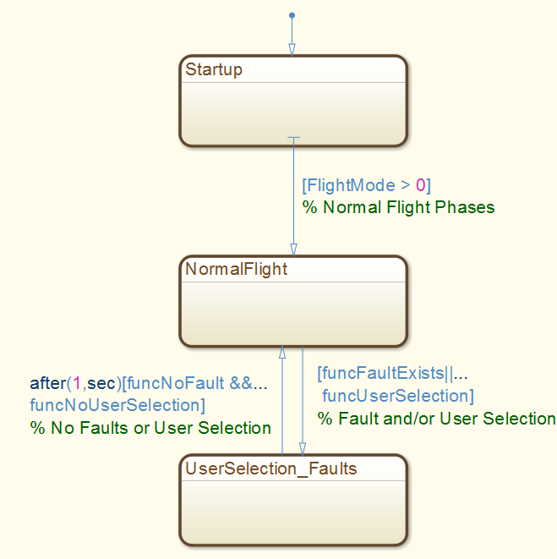
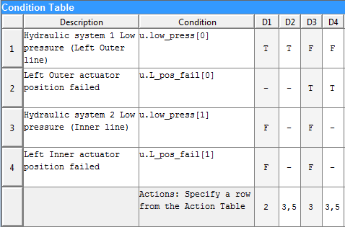
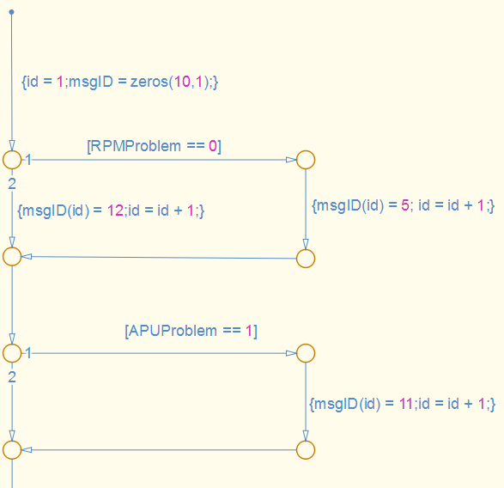
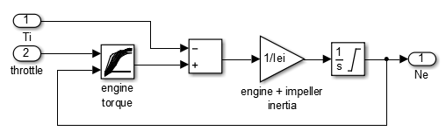
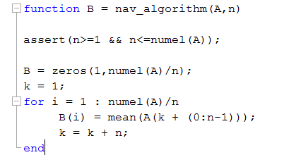
Designing Models
Use state machines for
Page Control
Truth Tables
Flow Charts
Block Diagrams
MATLAB/C
Notes:
We recommend the usage of state machines for representing the pages of the system. This is because with pages, it is easier to understand the different pages and which transitions are possible between pages.
The conditions for transitioning between states can be complex and you can use a combination of truth tables for combinatorial logic, flow charts for decision flow, block diagrams for control algorithms and MATLAB/C for textual algorithms. And with our tools, you can link the elements of the design with the requirements electronically.
As you are designing your models, you continuously verify them with simulation.

Slide 27
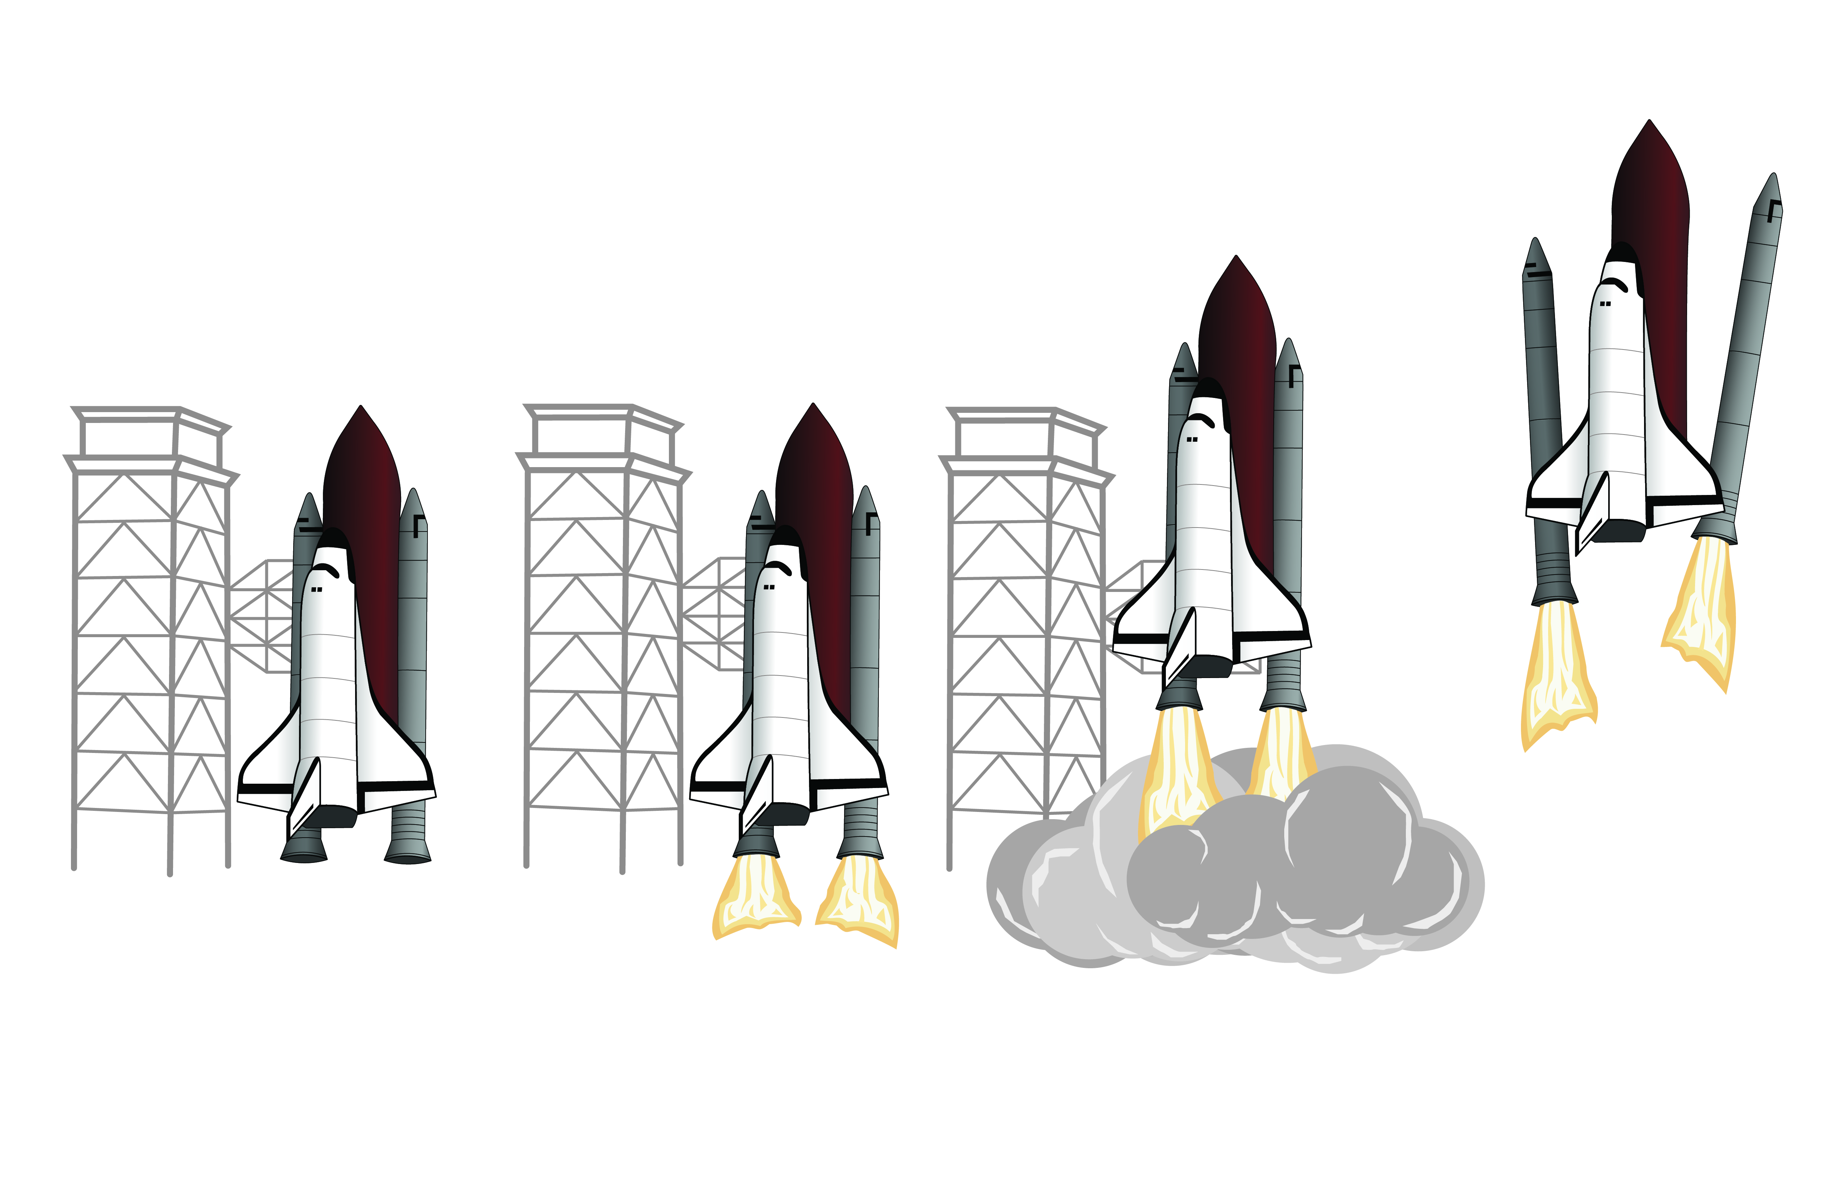
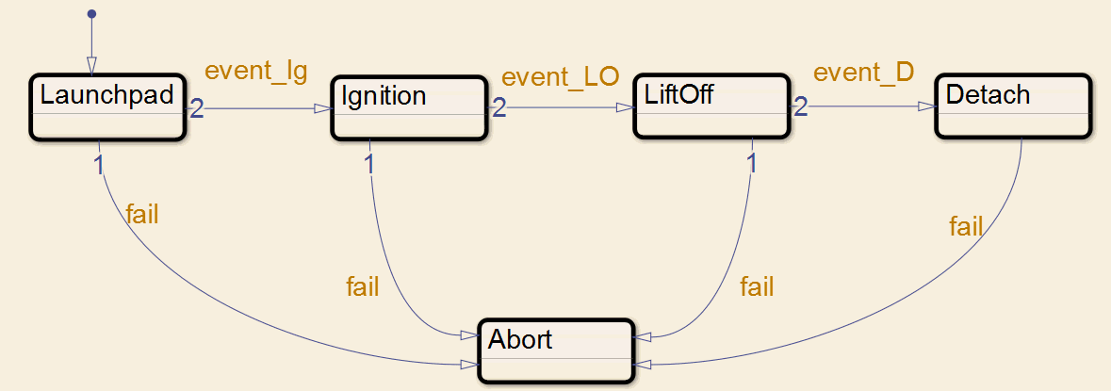
Simulation
Notes:
When you simulate the model you can understand and check how it behaves using animation as you can see in the model.
As the graphic in the screen shows you, by the way the clip on the bottom is from product, you notice how the logic in the system is progressing. There are additional debugging capabilities to pause and step through the logic to inspect it.
This step is very important as it helps the designer of the algorithm identify and eliminate issues with the design before any code has been written or any hardware is available.
After you have checked that your algorithm behaves as expected, you can then run your test suite on the model to make sure that it is meeting requirements.

Slide 28
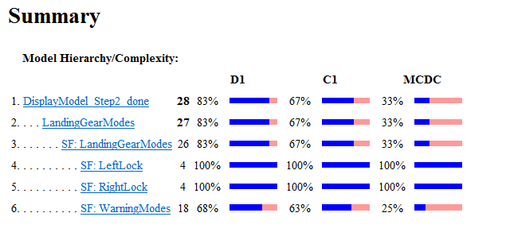
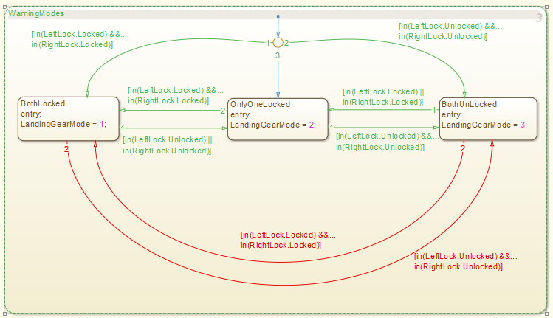
Verification and Testing
Requirements Traceability
Map model to requirements in
DOORS, Word, Excel, PDF, URL
Model Coverage Analysis
Dynamic – data collected during simulation
Based on the model structure
Verification of Design
Detect design errors
Prove Properties
Notes:
Not only your model, you can also link individual tests with requirements in DOORS, WORD and other formats. Then verification engine can then check whether the test suite completely exercises all parts of your model or it can run a static analysis to see if all parts of the model can be exercised based on its structure.
Further our tools use formal methods to detect design errors and prove properties.

Slide 29
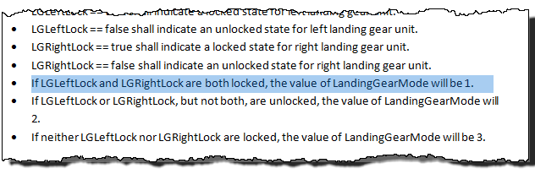
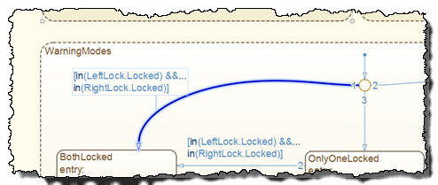
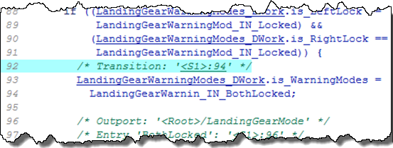
Notes:
Once you are satisfied with your design, can generate code from the model. Important to note that we generate reports that have electronic links to help you trace part of the model back to the code and back.
[Advance]
Not only that, the model is further linked with the requirements and so you have a complete mapping of the requirements text to the lines of code. You even have the option to include your textual requirements be included into your code as requirements.
In the next hour, we will go through this workflow but lets start with a quick introduction to state machines to get you up to speed with how it can be used to model complex logic.

Slide 31
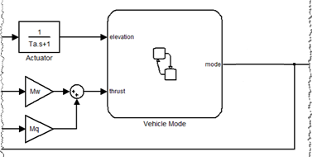
What is Stateflow?
Model and simulate decision logic
Develop mode-logic using state machines and flow charts
See how the logic behaves with diagram animation and integrated debugger
Notes:
Stateflow® is an environment for modeling and simulating decision logic in reactive systems. Using Stateflow, you can design supervisory control, task scheduling and fault management applications that can then call Simulink models to solve the dynamics of the problem at hand. In your simulation, you can also use MATLAB for data processing and data visualization.
Stateflow lets you combine graphical and tabular representations, including state transition diagrams, flow charts, state transition tables, and truth tables, to model how your system reacts to events, time-based conditions, and external input signals.
Using state machines with flow charts you can represent complex logic concisely and clearly.
You can use state hierarchy and concurrent execution of components to accurately describe the dynamics of the system.
When you simulate the model you can understand and check how it behaves using diagram animation. The debugger provides additional capabilities to step through the logic and understand it.

Slide 32
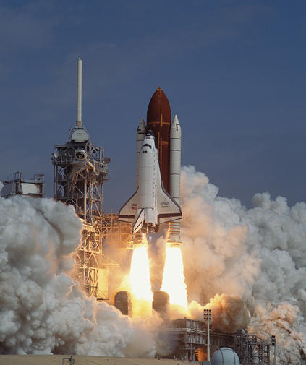
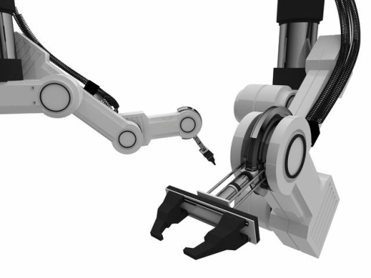
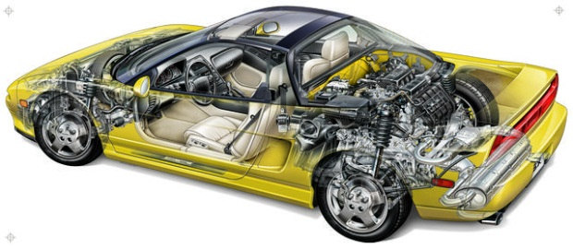
How does Stateflow work with Simulink?
Simulink is used to respond to continuous changes in dynamic systems.
Stateflow is used to respond to instantaneous changes in dynamic systems.
Real-world systems have to respond to both continuous and instantaneous changes.
suspension dynamics gear changes
propulsion system liftoff stages
robot kinematics operation modes
Use both Simulink and Stateflow so that you can use the right tool for the right job.
Notes:
Simulink is used to respond to continuous changes in dynamic systems.
Stateflow is used to respond to instantaneous changes in dynamic systems.
Real-world systems have to respond to both continuous and instantaneous changes.
For example, a car has continuous suspension dynamics and instantaneous gear changes.
A rocket has a propulsion system that changes continuously with time and distinct liftoff stages that change instantaneously.
Robots move in a continuous fashion, but have distinct modes of operation.
The point is that in order to model real-world systems, you should have both Simulink and Stateflow.

Slide 33
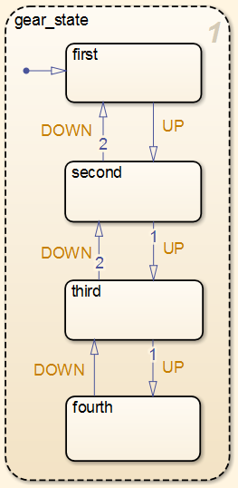
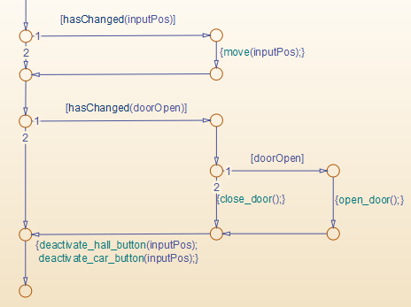
Why use Stateflow for Cockpit Display Logic?
Model modes of operation in Cockpit Display logic clearly with state machines in Stateflow
Represent complex conditional and event based logic in Cockpit Display logic with flow charts in Stateflow
Understand behavior of logic easily with animation and integrated debugger in Stateflow
Test and Verify your design using Model-Based Design tools before implementation
Notes:
In Stateflow, apart from being able to create the logic, you can also simulate it and view its behavior with animation. Like in this example, you can see that the states are highlighting as they become active. The capability to simulate and animate along with an integrated debugger makes it easy to step through logic and understand it.

Slide 34
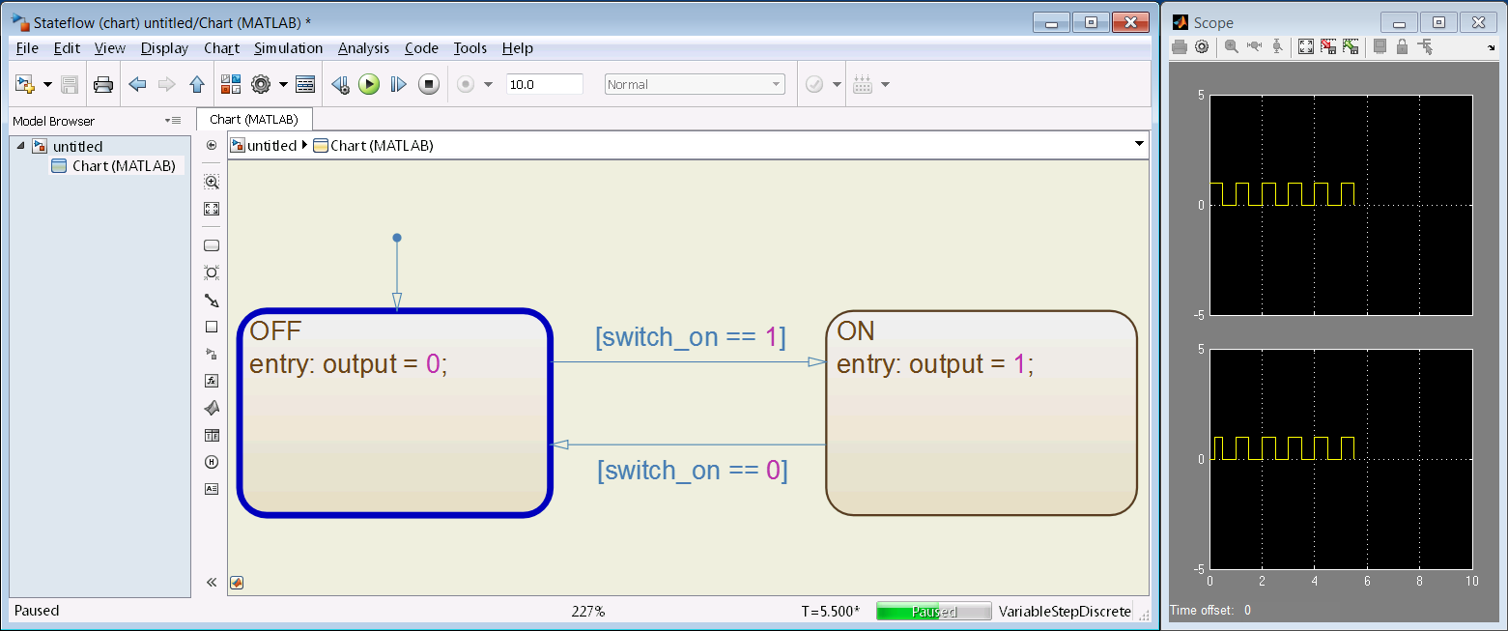
Lets Build a State Machine!

Slide 35
Overview of Concepts
STATES represent modes of operation
Exclusive States (OR)
Parallel States (AND)
TRANSITIONS represent paths between states
Types of functions supported:
Graphical
MATLAB
Simulink
Truth Tables

Slide 37
Designing Logic for Cockpit Displays
Warning Message Control contains complex conditional logic based on
Phases of flight
Modes of components/signal
Page Control contains complex mode logic based on
Hardware states (Startup, Running, Off)
Phases of Flight
Faults in system

Slide 38
Model Overview

Slide 40
Designing Logic for Landing Gear System

Slide 44
Key Points
Model-Based Design provides a complete solution to design, test and implement cockpit display logic
State machines and flow charts clearly represent logic for display systems
With Model-Based Design, you continuously test to check that the design meets requirements

Slide 45
What next?
Try out Stateflow, you already have access to it!
Learn more about Stateflow at:
http://www.mathworks.com/products/stateflow/
Short Getting Started Videos
Webinars:
Control Logic Made Easy with Stateflow
Getting Started with Stateflow (Parts 1,2,3)
Stateflow Documentation

